Slide 1
Unit 3
Stacks

Slide 2

What is Stack?
Stack is one of the most commonly used linear data structure of variable size.
In stack insertion and deletion can take place only at one end called as TOP.
Pop
Pop
Push

Slide 3
In stack, insertion operation is known as push and deletion operation is known as pop.
Stack is also called as Last In First Out(LIFO).
Though stack is restricted kind of data structure but it has many applications in programming.

Slide 4
Operations on the Stack
Two basic operations performed on stack are:
Push
Pop
  Push operation refers to the insertion of a new element into the stack.
  New element will be inserted at the top of the stack
  Push operation can be performed only when stack is not full.
  If stack is full and an attempt is made to insert the new element in the stack then this condition is called as STACK OVERFLOW.
  Pop operation refers to the removal of an element from the top of the stack.
  Pop operation can be performed only when the stack is not empty
  When stack is empty and we are attempting to remove an element then this condition is known as STACK UNDERFLOW.

Slide 6
Memory Representation of Stack
There are two common ways to implement a stack.
It can be represented in memory by means of an array or a linked list.
Array Representation of Stack with some restrictions:
The stack must contain homogeneous data elements.
One must specify the upper bound of the array. i.e. maximum size of the stack must be defined before implementing it.

Slide 8
Algorithm to perform Pop Operation

Slide 9
Linked List representation of the stack
Stack can be implemented using Linked List.
Using linked list for representing stack, we can eliminate the drawback which come across while implementing stacks using an array.
There is no need to know in advance the size of the stack.

Slide 14
Applications of Stack
Evaluation of Arithmetic Expression
  Infix Notation
  It is the most common notation that is used while expressing arithmetic expression.
  In this notation operator is placed between its operands. For eg. To multiply m and n we write it as m X n. m*n, p/q
  While solving the infix notation, the main consideration is precedence of the operators and their associativity. For example
  e = q X r + s

Slide 15
Precedence table

Slide 17
Example
e = 5 X 3 + (60-36)/6+ (3 X 10) +7

Slide 18
Prefix Notation

Slide 20
Example
=([+ab]/ d^((e-f) + g))
= ([+ab]/d^[-ef]+g)
=([+ab]/d^[+ -e f g])
= ([+ab]/[^d + - e f g])
=/ + a b ^ d + - e f g
I = ( x * y) + (z + ((a + b –c) * d )) – I * (j /k)
= [*xy]+(z+(([+ab]-c)*d)) – I *[/jk]
=[*xy]+(z+([-+abc]*d))-[*i/jk]
=[*xy]+(z+[* - + abc d] –[*i/jk]
=[*xy] + [ + z * - + a b c d ] – [*i/jk]
= + * x y + z * - + a b c d – [*i/jk]
=- + * x y + z * - + a b c d *i/jk
I = ((a + b) / d^((e-f) + g))

Slide 21
Postfix Notation

Slide 22
Example
I = (x-y) * ((a+b)/f) = [xy-]* ((a+b)/f)
= [x y -] * ([a b +] / f)
= [x y -] * [ a b + f /]
= x y – a b + f / *
I = ( x * y) + (z + ((a + b –c) * d )) – I * (j /k)
= [xy*]+(z+(([ab+]-c) *d))-I *[jk/]
=[xy*]+(z+[ab+c-]*d) – ijk/*
=[xy*]+(z+[ab+c-d*]-ijk/ *
=xy*+ zab+c-d*+ijk/*-
=xy* zab+c-d*++ijk/* -
I = (a-b)/c
= (ab-)/c
=ab – c /

Slide 23
Algorithm to convert infix expression into postfix expression

Slide 24
Example
Consider, I = (6+2)*5- 8/4

Slide 25
Evaluation of postfix notation

Slide 26
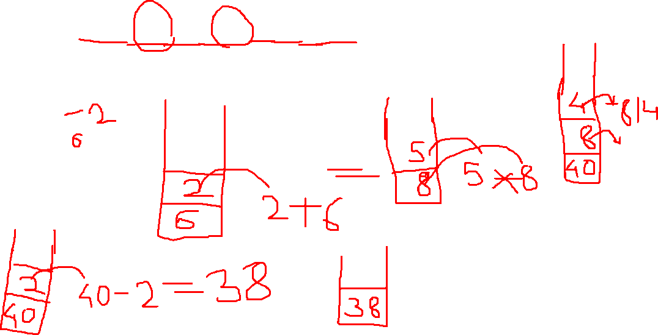
Example
6

Slide 28
Matching Parenthesis
Stack can be used for syntax verification of the arithmetic expression for ensuring that for each left parenthesis in the expression there is corresponding right parenthesis.

Slide 29
Matching Parenthesis

Slide 31
Recursion
It is an important and powerful tool for developing algorithms.
It is the ability of the procedure to call itself
If we want to defined the procedure recursively, it must satisfy the following to conditions.
There must be decision criteria that stops the further call to the procedure called as base criteria.
Each time a procedure call itself either directly or indirectly, it must be nearer to the solution.

Slide 33
Factorial(n)
if n=0 then
set Fact=1
Return
Else
set Fact= n*Factorial(n-1)
Return

